Slide 1
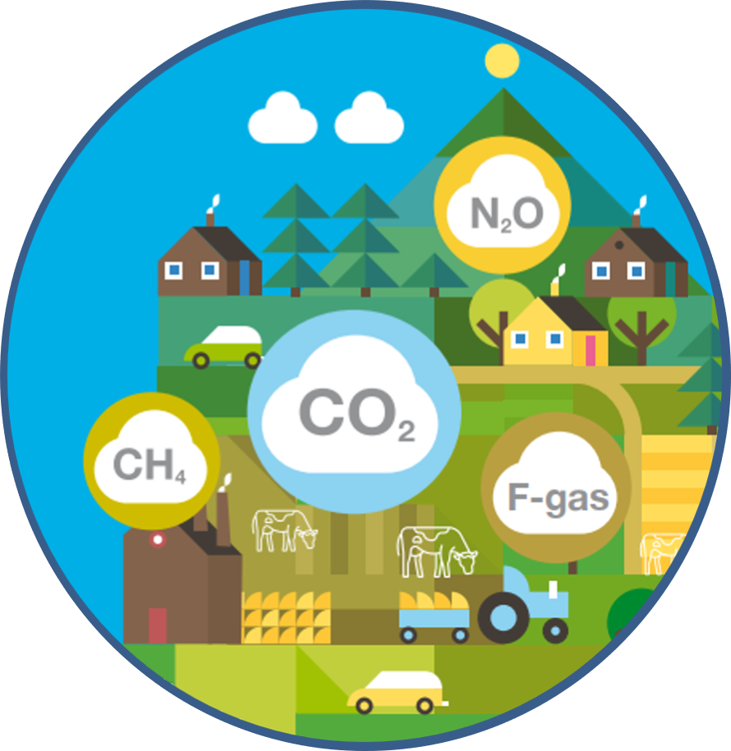
Greenhouse Gas emission in the agriculture sector
Signpost Farm General Assembly 29th August 2022

Slide 2
Role of EPA Emissions Inventories and Projections
EPA compiles National Inventories and Projections of Ireland’s Greenhouse Gas
  International: Reporting to EU and United Nations Framework Convention on Climate Change
  National: Climate Action and Low Carbon Development (Amendment) Act 2021; Carbon Budgets
Reportable GHG
    Carbon Dioxide
    Methane
    Nitrous Oxide
    F-Gases HFCs, PFCs, SF6 NF3
Reported sector and by Gas

Slide 3
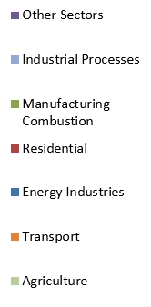
Sectoral Share of GHG emissions

Slide 4




Increase in total emissions of 4.7%
compared to the 2020 levels, 1.1% above the
(pre COVID restrictions) 2019 level. Increased
Agriculture, Transport, Energy Industries emissions
More Coal and less Wind means more emissions from electricity generation. Tripling of Coal & Oil use in 2021 Vs 2020.
Transport emissions rebound with 6.1% increase following partial lifting of COVID restrictions. Agriculture emissions increase by 3%.

Slide 5
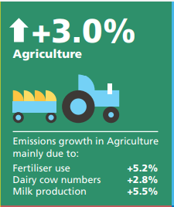
Greenhouse Gas Emissions in Agriculture- 2021
2021 – 23.1 Mt CO₂ eq
Source EPA July 2021
Agriculture GHG emissions by source

Slide 6
Agriculture
Greenhouse Gas Emissions 2021
Agriculture emissions up 3% in 2021
  Nitrogen fertiliser inputs were higher in 2021, up 5.2%, and CO₂ emissions from liming were both up 49.5%.
  Increases in livestock numbers.
    Dairy herd continued to increase, for the 10th consecutive year, (+2.8% in 2021) with a 5.5% increase in total national milk production.
    Other cattle numbers also increased in 2021 by 0.3%
    Sheep and pigs also increased (0.3% and 4.5% respectively)
  Latest CSO data suggests 2.8% increase in dairy cows in 2021 and a 5.5% increase in milk production
  Fertiliser N increased by 5.2% in 2021

Slide 7
National Emission Inventory
Livestock
N fertiliser & Lime
Cattle
Sheep
Pigs
Poultry
Other livestock
Fert type
Grazing
Housed
Manure Management
Housing type
Duration
Land application
Storage
Manure type
Application
method
Manure type
Store type
Duration
Timing

Slide 8
Inventory compilation: Data sources
Emission Statistics Team
SEAI
DAFM
Teagasc
OEE
EPA
Emissions Trading MRV
EPA
Emissions Trading Registry EPA
Waste Statistics EPA
Marine Institute
EPA Research
Gas Networks Ireland
CSO

Slide 9
Inventory compilation
Emissions = Activity data * Emission Factor
Based on internationally agreed guidelines – Intergovernmental Panel on Climate Change
Follow the principles of TACCC
  Transparent: clearly explained methods and assumptions
  Accurate: measure of exactness – neither over or under estimated as far as that can be ascertained
  Consistent: Internally consistent across the time series
  Comparable: between counties, follow compilation & reporting guidelines
  Complete: cover all emissions that take place in Ireland
Reviewed/audited annually – UNFCCC and ESD
Latest published data 2021; Final data submitted to UN 16 months after the year end. Provisional 2021 data published July 2022

Slide 10
Inventory refinement
This a normal part of the inventory process as data and scientific knowledge develops
Ongoing need for updates and improvement as science and knowledge progresses
Refinement is dependent on national research and national activity data
  Measurable; Reportable; Verifiable
Ongoing engagement with Teagasc, DAFM and other stakeholders
There is a clear approach for data inclusion in the inventory
  National reports e.g. through survey findings
  Peer reviewed scientific publications
  Must be representative of national circumstances
Stands up to scrutiny in both EU Effort Sharing Decision and UNFCCC review/audit

Slide 11
Climate Act Target & Carbon Budgets

Slide 12
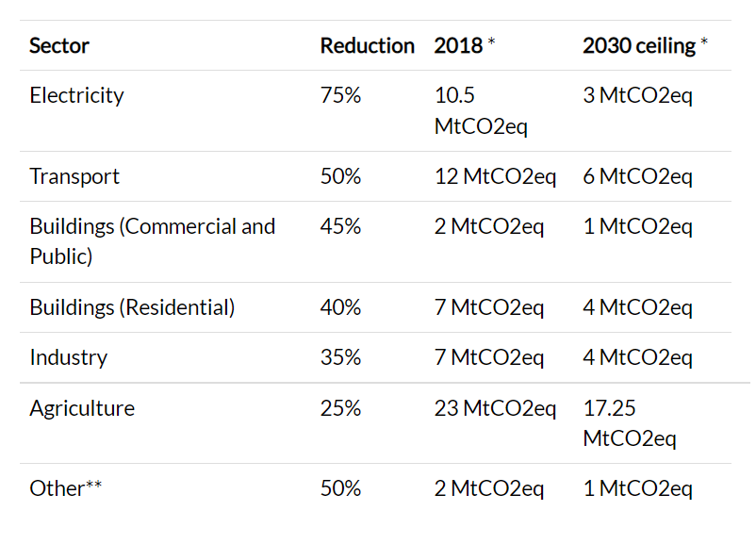
Sectoral Ceilings

Slide 13
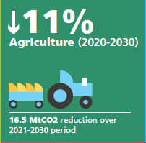
Projections & Policies & Measures
Projections follow national inventory approach
  Forward looking inventory
  Emissions estimated at the same level of disaggregation
FAPRI – Ireland model – future activity data
Two scenarios – With Existing Measures and With Additional Measures
A reduction in emissions will require implementation of measures as outlined in the MACC/AgClimatise/CAP’21
Published June 2021
Based on 2019 Climate action plan

Slide 14
Projections Data- agriculture
Sector contributes 37.5% of total GHG in 2021- this is projected to rise to 43.4% by 2030
In the WAM scenario emissions are projected to decrease to approximately 17.8 Mt CO2 eq by 2030 which is a 20.3% reduction over the period 2020-2030.
Assumes Implementation of the CAP 2021, and includes measures like:
  nitrogen use efficiency;
  use of protected urea products;
  improved animal health;
  extended grazing;
  reducing crude protein in pigs;
  low emission slurry spreading; and
  inclusion of clover in pasture swards

Slide 15
Conclusion
Evidence is clear- need for deep emissions reductions across all sectors
Ireland cannot reach its climate ambitions without the agricultural sector delivering its contribution
There are significant co-benefits to be derived from tackling GHG reductions in agriculture- in particular water quality
Programmes like Signpost Farms contribute to the agricultural sector efforts to reduce agricultural emissions in line with national policy objectives
Time now to implement the policies that we know can deliver GHG reductions

Slide 16
END

